Slide 1
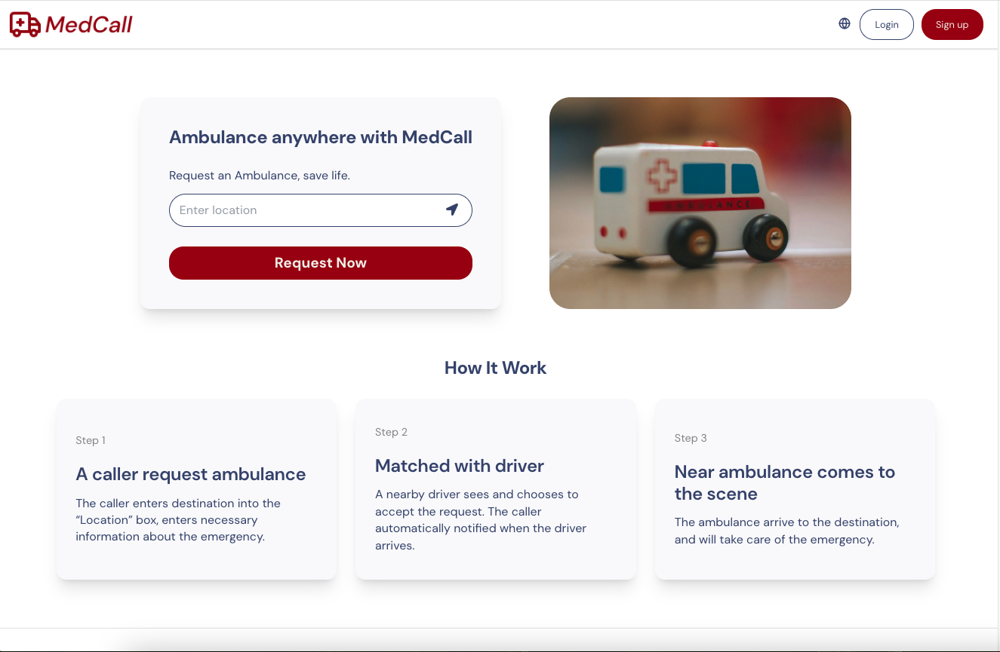
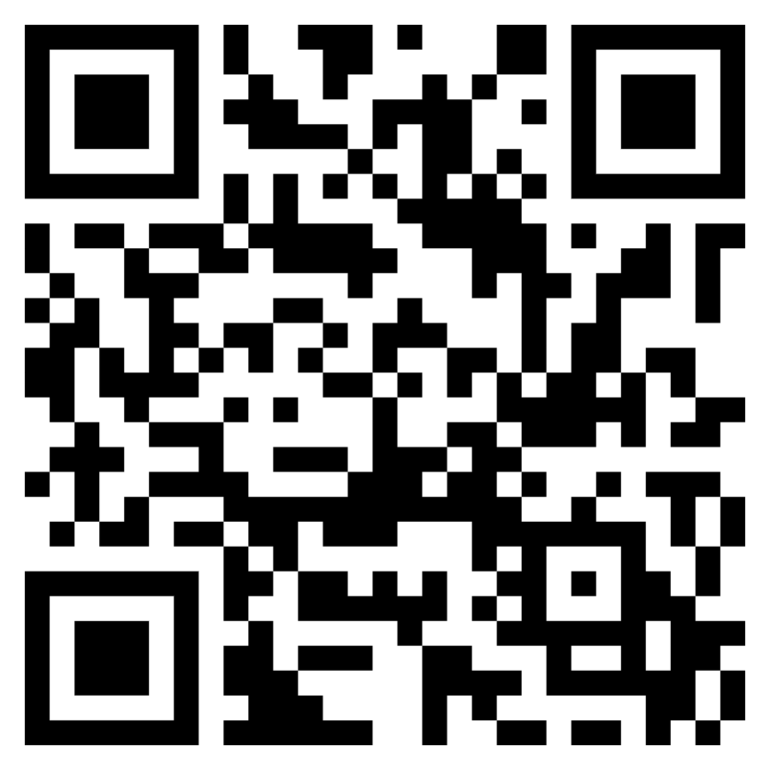

Capstone Project Phase B – 61999
MedCall Supervisor: Mr. Alex Keselman
Team: Tareez Ghandour & Leen Hawa
SCAN ME

Slide 2

Introduction
The Solution
Used Technology
UML Diagrams
Testing
Challenges

Slide 3


Introduction
Emergency medical services (EMS) are essential for any community.
Current systems face significant challenges that lead to delays in help’s arrival.

Slide 4







The Problem
Traffic
Delayed data
Communication
Poor phone service
Language barriers
Stressed callers

Slide 5

Introduction
The Solution
Used Technology
UML Diagrams
Testing
Challenges

Slide 6

Our Solution
SCAN ME

Slide 7
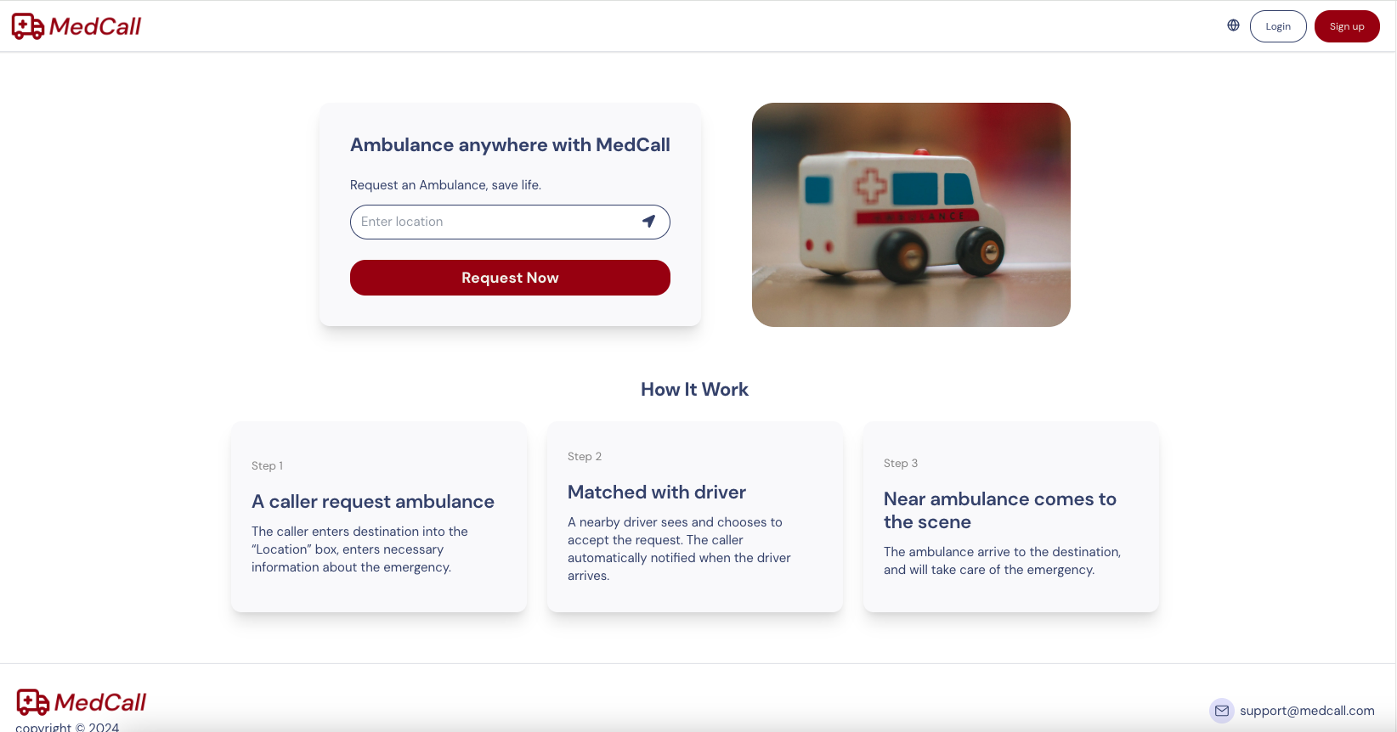
User-Friendly Platform

Slide 8
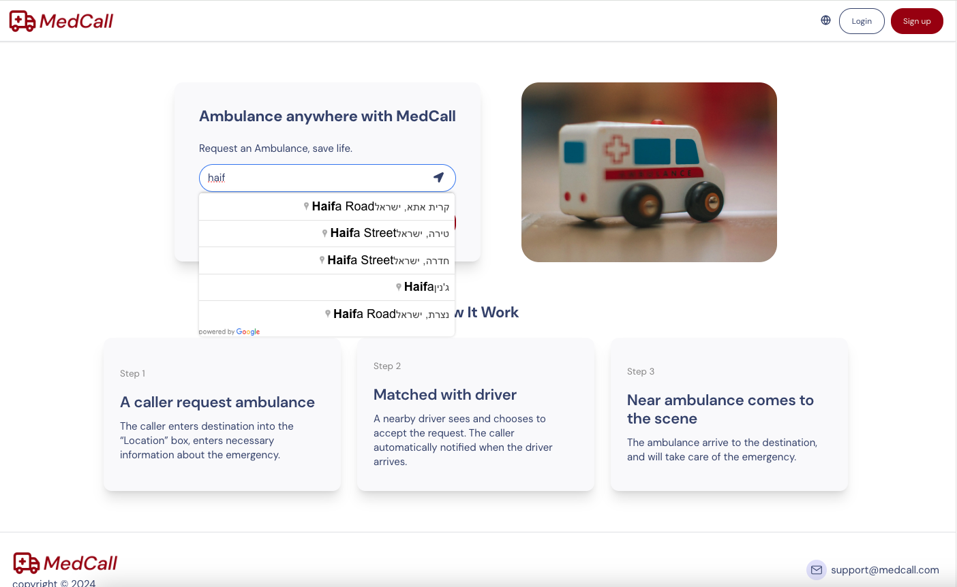
User-Friendly Platform

Slide 9
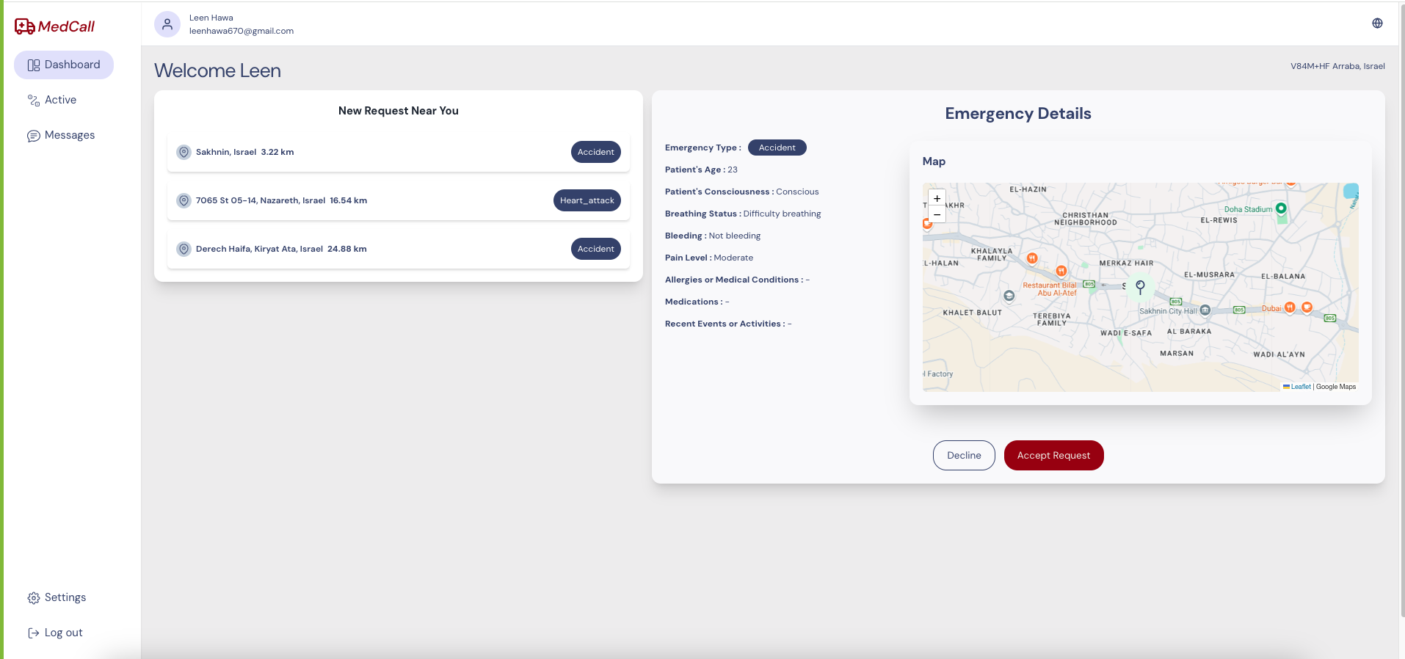
Nearest Neighbor Algorithm

Slide 10
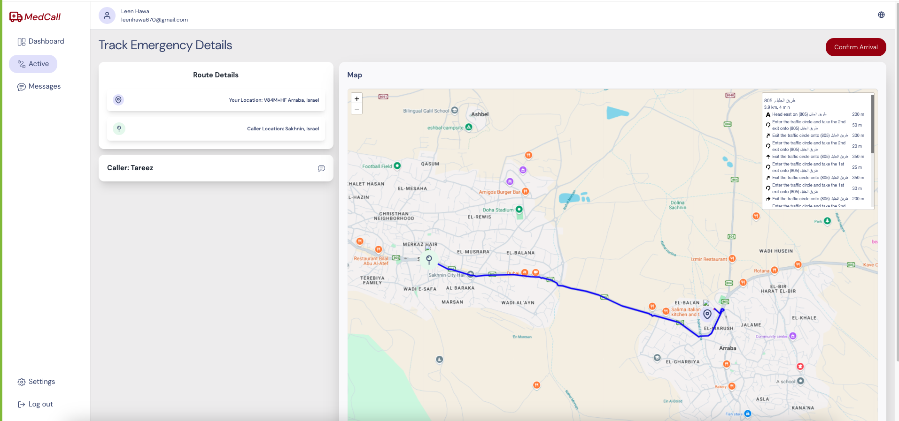
Live Tracking

Slide 11
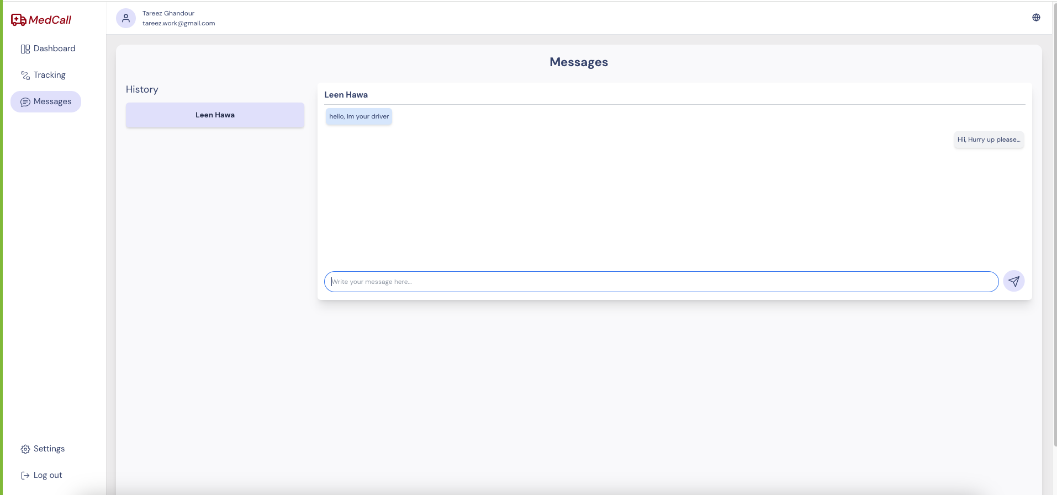
Real-Time Communication

Slide 12

Introduction
The Solution
Used Technology
UML Diagrams
Testing
Challenges

Slide 13
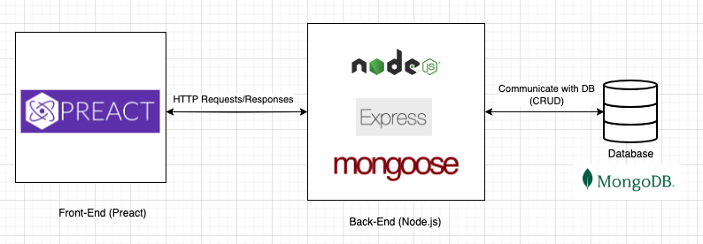
Used Technology

Slide 14

Introduction
The Solution
Used Technology
UML Diagrams
Testing
Challenges

Slide 15
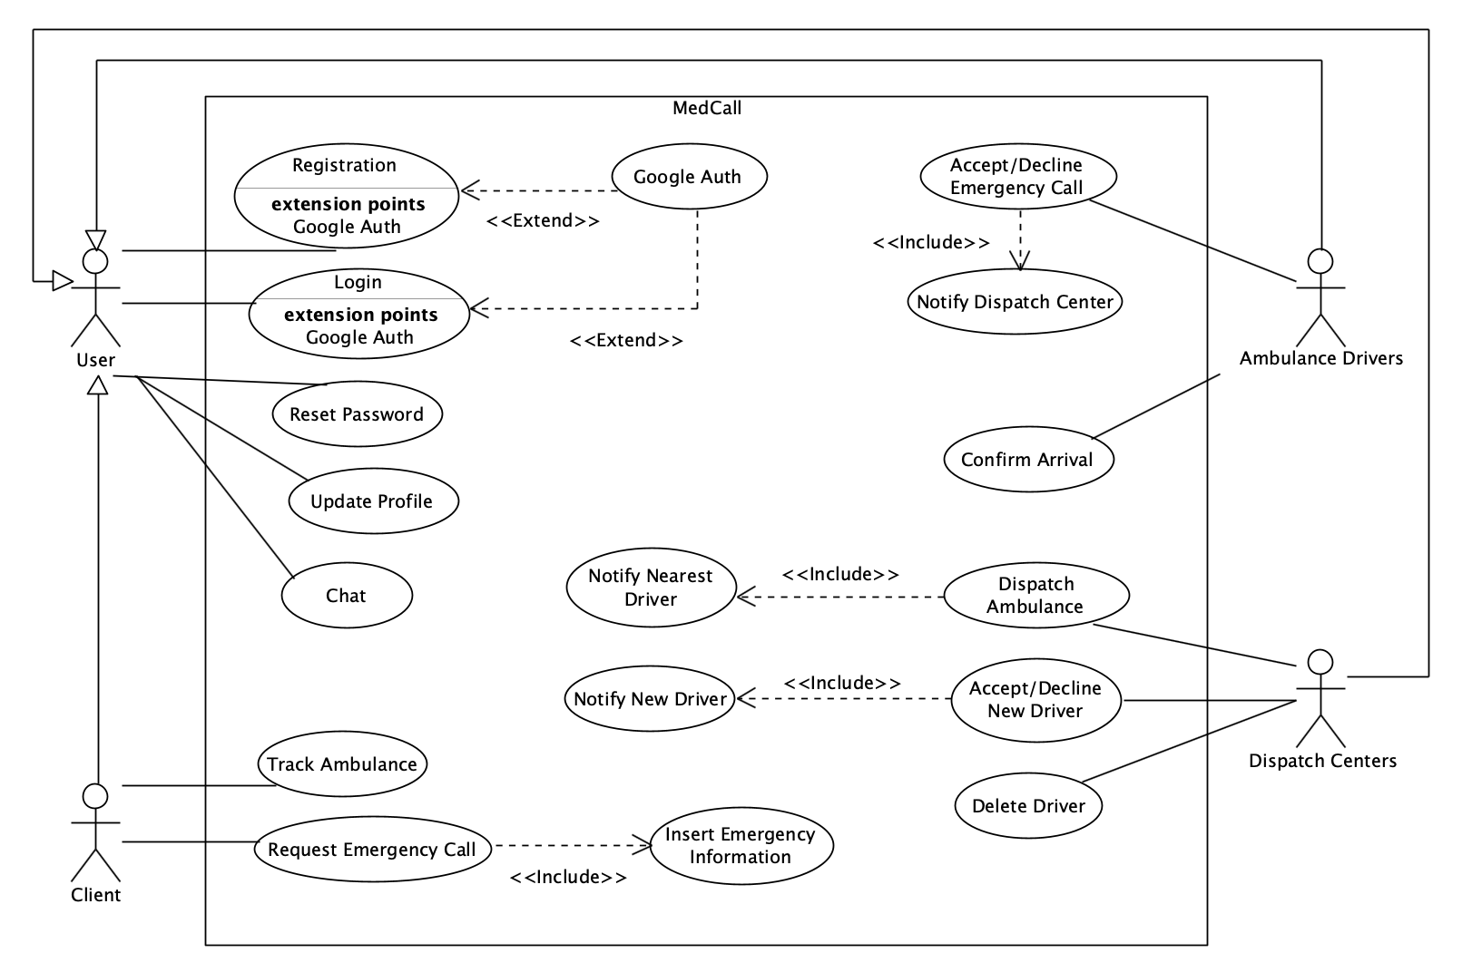
Use-Case

Slide 16
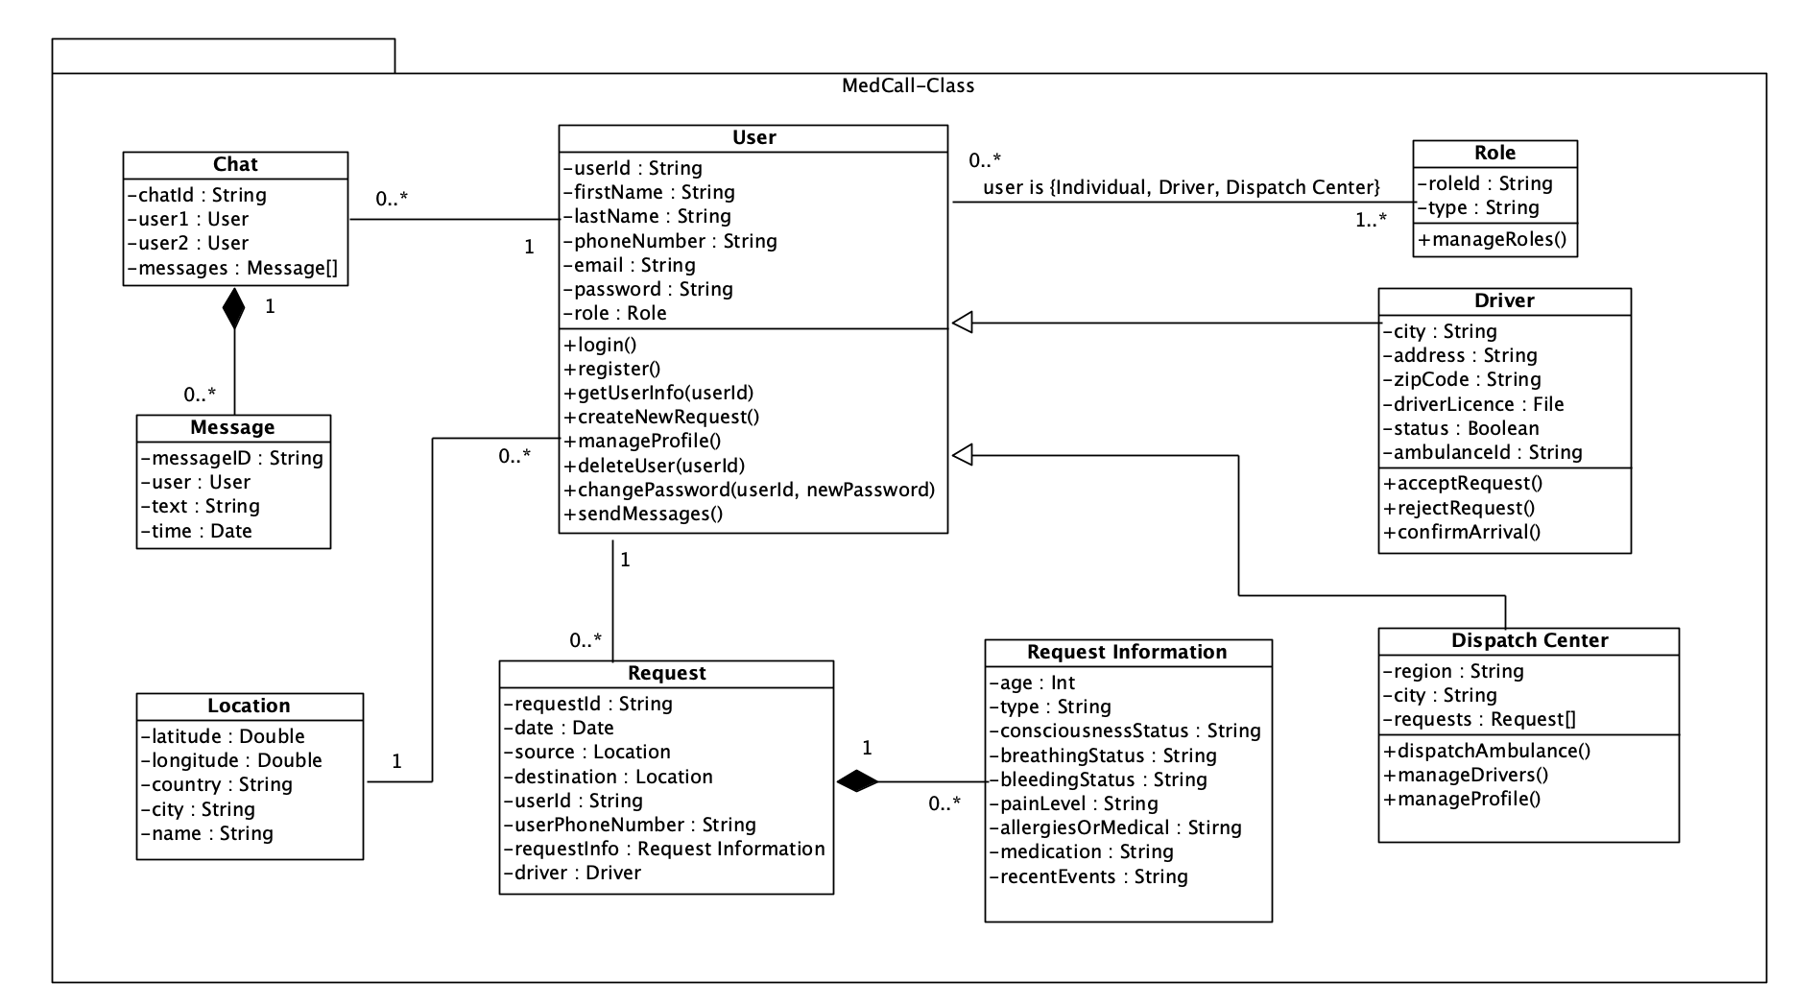
Class Diagram

Slide 17
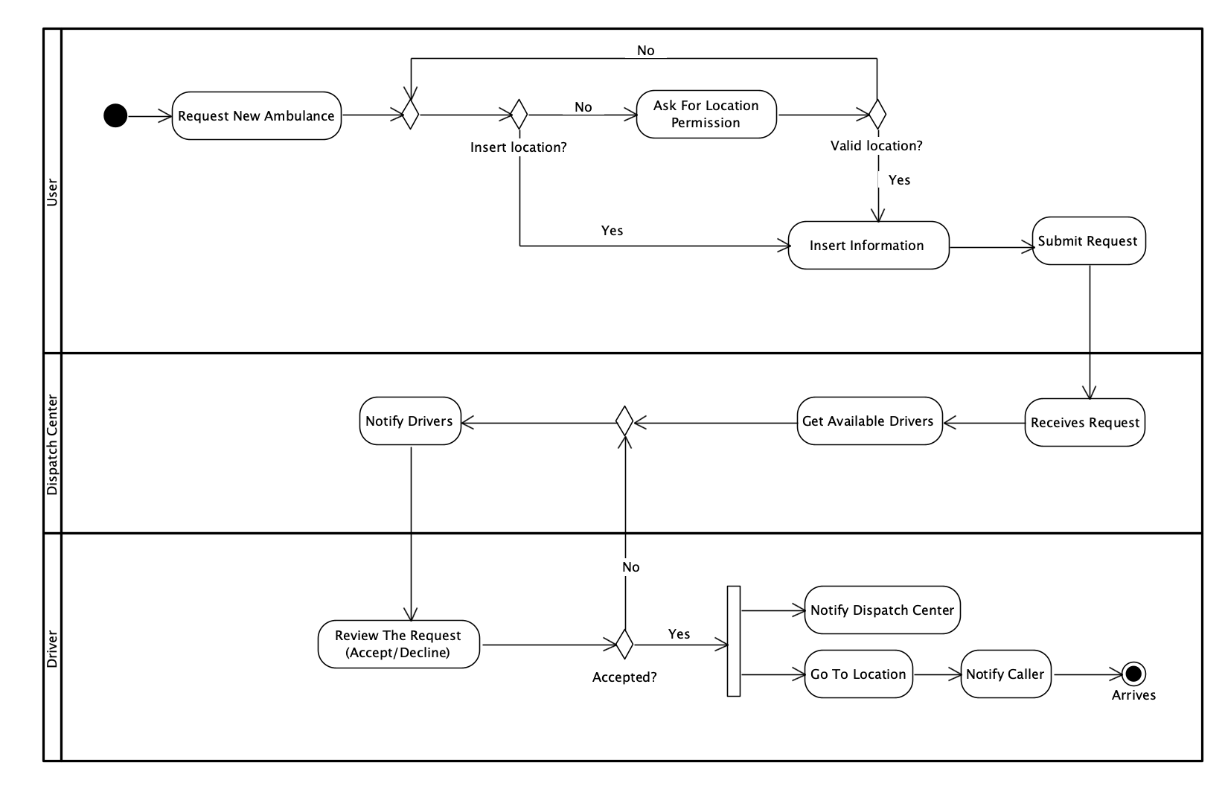
Activity Diagram

Slide 18
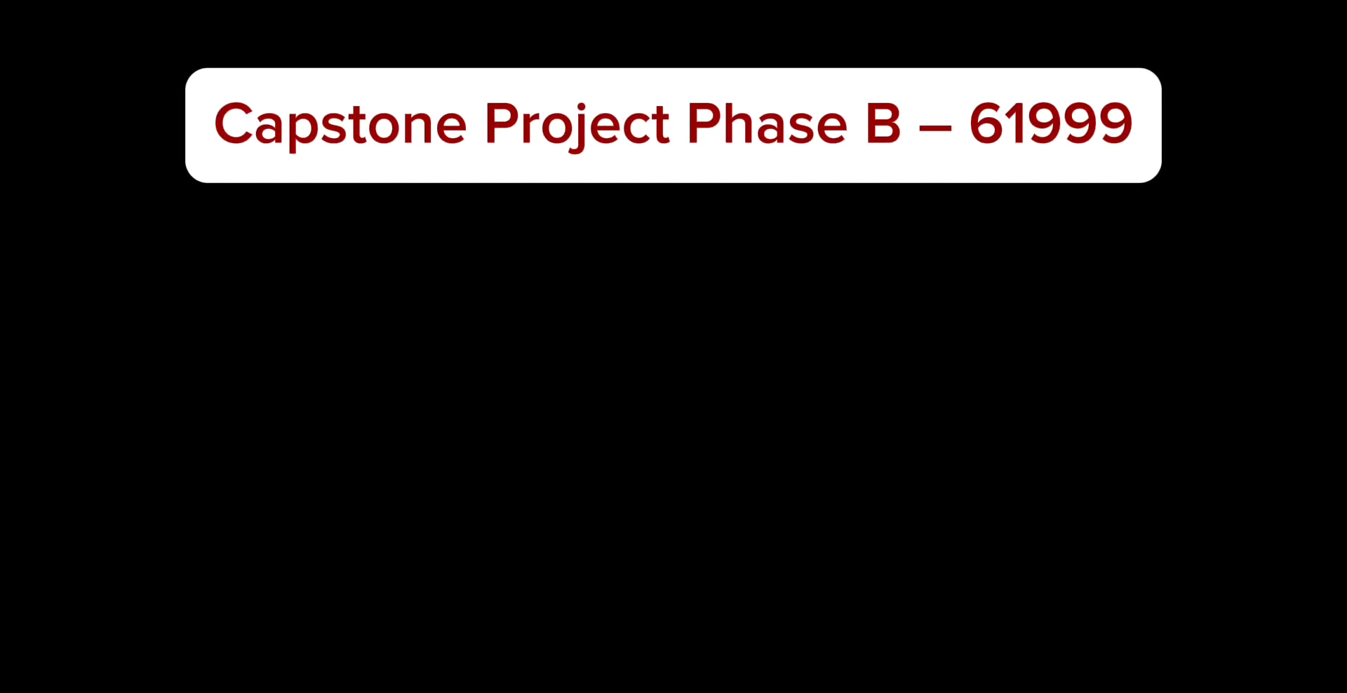
Video Demo
Notes:
https://drive.google.com/file/d/1p4LjtIRHJdeNYZMB-gtRtRVF0onAbjdF/view?usp=drive_link

Slide 19

Introduction
The Solution
Used Technology
UML Diagrams
Testing
Challenges

Slide 20
Tests Plan For Registration
Test N. | Test Description | Expected Result
1 | Attempt to register a new user with valid input data | The user registration should be successful, and the user should receive a confirmation message indicating successful registration.
2 | Attempt to register a new user with and empty input | The registration process should fail, and the user should receive an error message “Please fill in all the fields.”
3 | Attempt to register a new user with an invalid email format (e.g. missing ”@”) | The registration process should fail, and the user should receive an error message “Please enter a valid email.”
4 | Attempt to register a new user with a weak password | The registration process should fail, and the user should receive an error message “Password must be at least 8 characters with uppercase, lowercase, and number.”
5 | Attempt to register a new user with an email address that is already registered in the system. | The registration process should fail, and the user should receive an error message “Email already in use. Please choose another.”

Slide 21
Tests Plan For Login Process
Test N. | Test Description | Expected Result
6 | Attempt to login with valid credentials | The login process should be successful, and the user should be redirected to their account dashboard.
7 | Attempt to log in with an empty input | The login process should fail, and the user should receive an error message “Please fill in all the fields.”
8 | Attempt to log in with an invalid credentials | The login process should fail, and the user should receive an error message “Email or password is wrong. Please try again!”
9 | Attempt to log in with an email address that is not registered in the system. | The login process should fail, and the user should receive an error message “Email not found. Please signup first.”
10 | Handle internal server error while login | The login process should fail, because of server error and get http code 500

Slide 22
Tests Plan For New Request
Test N. | Test Description | Expected Result
11 | Attempt to request a new ambulance with valid information. | The request should be successfully submitted, and the nearest available ambulance should be dispatched to the specified location.
12 | Attempt to request a new ambulance without providing a location. | The request should fail, and the user should receive an error message “Must enter a location.”
13 | Attempt to accept an ambulance request without providing all necessary information. | The request should fail, and the user should receive an error message “Please fill in all the fields.”
14 | Verify that the user receives a confirmation message after successfully requesting a new ambulance. | The user should receive a confirmation message confirming that their request has been received.

Slide 23
Tests Plan For Accept/Decline/Edit Drivers
Test N. | Test Description | Expected Result
15 | Attempt to accept a driver request with valid information. | The request should be successfully accepted, and the driver should receive a confirmation message.
16 | Attempt to accept a driver request with an invalid information | The acceptance process should fail, and the driver should receive an error message "Invalid request. Please provide all necessary information."
17 | Attempt to decline a driver request with valid information. | The request should be successfully declined, and the driver should receive a confirmation message.
18 | Attempt to edit driver information with valid input data. | The driver information should be successfully updated, and the driver should receive a confirmation message.
19 | Attempt to edit driver information with missing necessary information. | The update process should fail, and the dispatch center should receive an error message "Please fill in all the required fields."

Slide 24
Tests Plan For Accept/Decline/ Request
Test N. | Test Description | Expected Result
20 | Driver accepts an ambulance request nearby with valid information. | The driver should successfully accept the request, and the caller and dispatch center should receive confirmation.
21 | Driver declines an ambulance request nearby. | The driver should successfully decline the request, and the dispatch center should receive confirmation.
22 | Driver attempts to accept an invalid ambulance request nearby | The acceptance process should fail, and the driver should receive an error message "Invalid request."
23 | Handle internal server error while accept request | The acceptance process should fail, because of server error and get http code 500

Slide 25
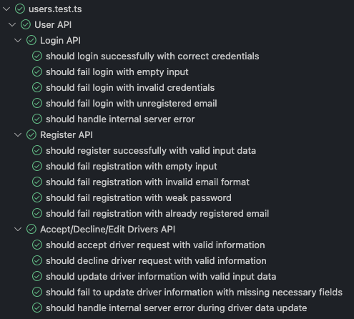
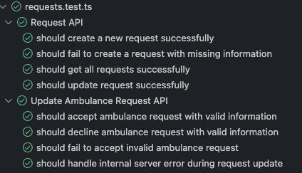
Tests Results
We use Jest, a JavaScript testing framework, for efficient testing and reliable code coverage.

Slide 26

Introduction
The Solution
Used Technology
UML Diagrams
Testing
Challenges

Slide 27
Challenges
Adapting to and mastering new technologies like Preact, Node.js, and MongoDB.
Designing an interface that is both functional and easy to use for all users.

Slide 28



